Slide 1
Temporal Host Transcriptional Responses to Chlamydia Infection Following CPAF-Based Vaccination
05/07/2026
Esther Zhou
Notes:
Hi everyone, my name is Esther Zhou, and I’m a master’s student in Biostatistics. Today I’ll be sharing the analysis results I’ve been working on for the Chlamydia vaccine study.

Slide 2
Study Overview
Study Design:
Vaccinated vs naive mice
Time points: day −2, 4, 6, 11
Goal: identify how vaccination changes host transcriptional response after infection
Analysis Overview:
Cell Ranger output quality control
Chlamydia gene counts assessment
Exploratory analysis of host gene expression
Timepoint-specific differential expression
Time-dependent expression analysis
Timepoint-specific GSEA
Notes:
I know some of you may already be very familiar with the study, but I’ll start with a brief overview of the design and the data, just to make sure we’re all on the same page.
This study compares vaccinated and naive mice across four infection time points: day −2, 4, 6, and 11. My analysis focused on host transcriptional responses after infection and whether those patterns differed by vaccination status.
I’ll start with QC and exploratory analysis, then move into timepoint-specific differential expression, and the time-dependent expression analysis, where we compared changes from baseline to each post-infection time point between vaccinated and naive mice. At the end, I will talk about the timepoint-specifi GSEA results.

Slide 3
Quality Control and Sample Filtering
QC metrics included mapping rates, sequencing depth, and sample-to-sample correlation.
Notes:
For quality control, I evaluated multiple sample-level metrics, including the percent of reads mapped confidently to the mouse genome, sequencing depth across samples, and sample-to-sample correlation heatmaps.

Slide 4
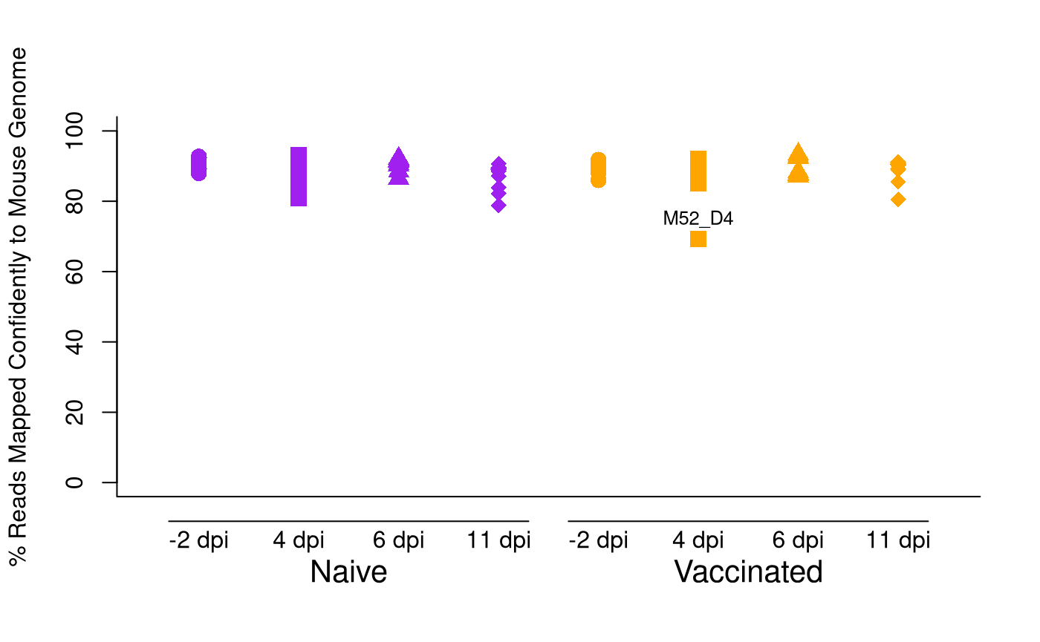
Percent Reads Mapped Confidently to the Mouse Genome
Notes:
In this plot, most samples had relatively high mouse mapping percentages.
However, one vaccinated day 4 sample, M52_D4, showed noticeably lower mapping compared with the other samples. At this stage, I flagged this sample for further QC evaluation rather than excluding it based on this metric alone.

Slide 5
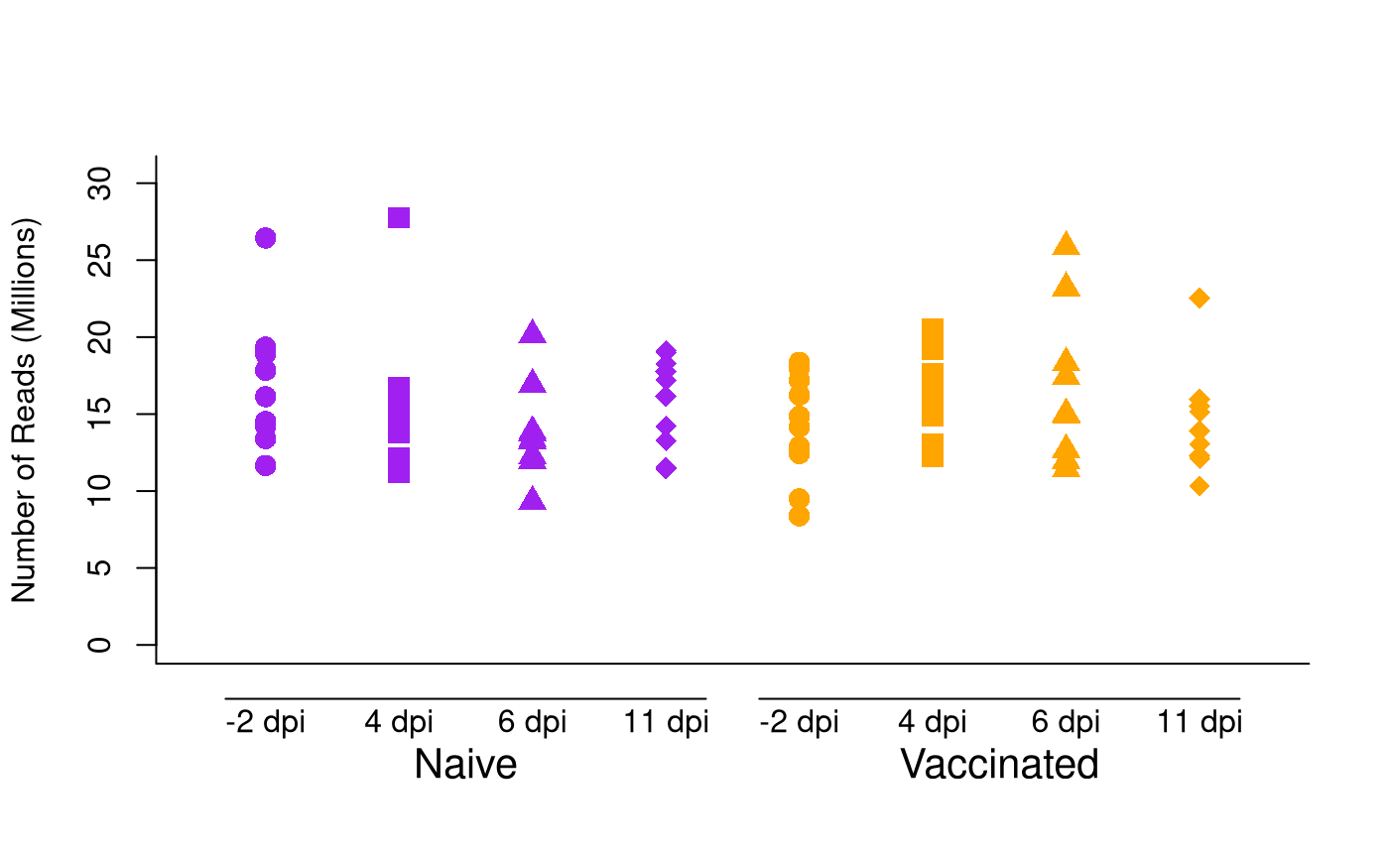
Sequencing Depth Across Samples
Notes:
Here, I checked sequencing depth across samples. Overall, all samples had acceptable sequencing depth.

Slide 6
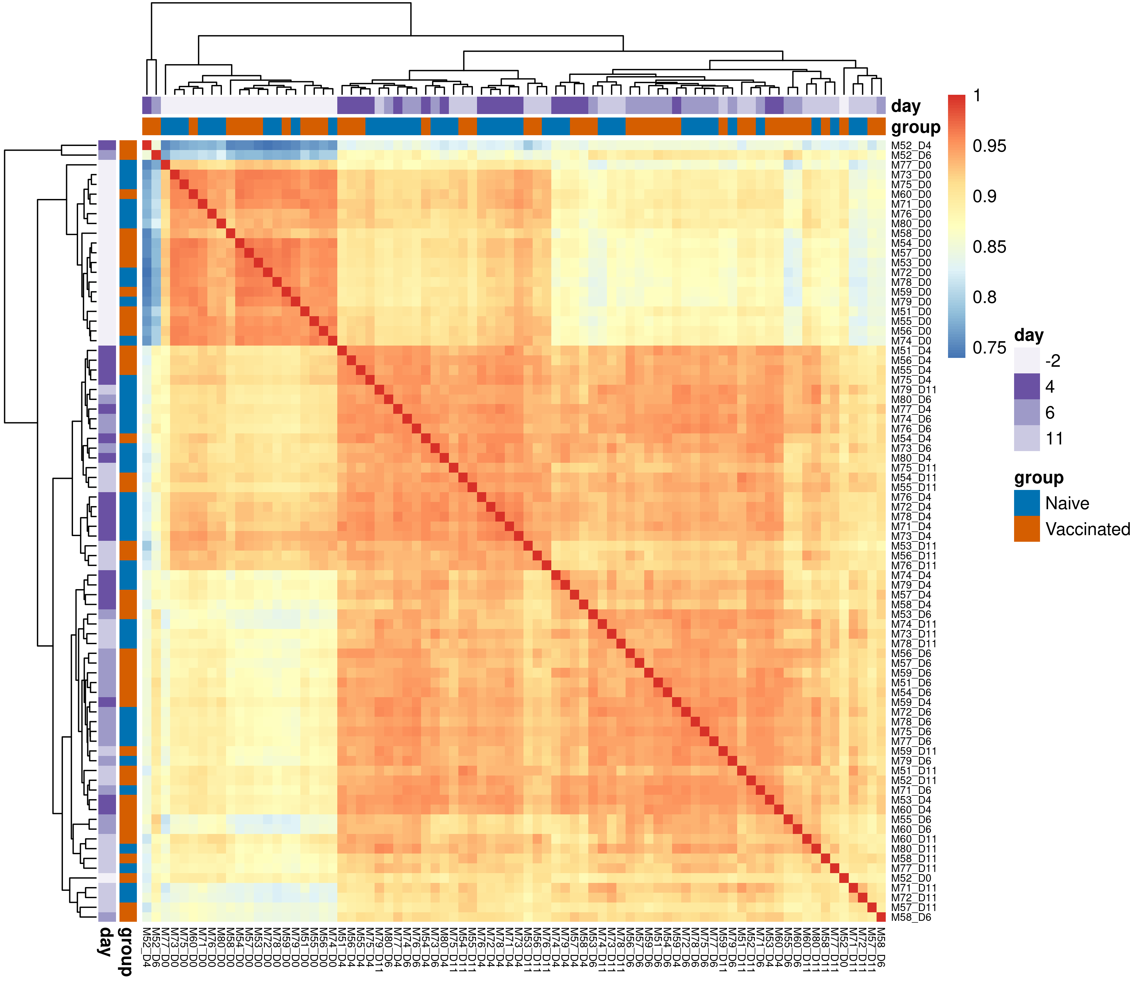
Sample-to-Sample Correlation of Host Gene Expression
Host gene log-CPM
Pearson correlation
Complete-linkage clustering
Notes:
Next, I examined sample-to-sample correlation based on host gene expression. This heatmap was computed using host gene log-CPM values, with samples ordered by hierarchical clustering using complete linkage.
Overall, most samples showed relatively high correlation, but M52_D4 had lower correlation with the rest of the dataset. Together with its lower percent of reads mapped confidently to the mouse genome, this suggested that M52_D4 was a lower-quality sample. Therefore, I excluded it from downstream exploratory and differential expression analyses.
CPM stands for counts per million, which normalizes gene counts by sequencing depth. I used log-CPM values so samples with different total read counts could be compared more fairly.
Complete linkage is the hierarchical clustering method used to order the samples in the heatmap. It groups samples based on their overall expression similarity.

Slide 7
Exploratory Analysis
Notes:
After excluding M52_D4, I moved on to exploratory analysis to examine global host gene expression patterns by group and time point.

Slide 8
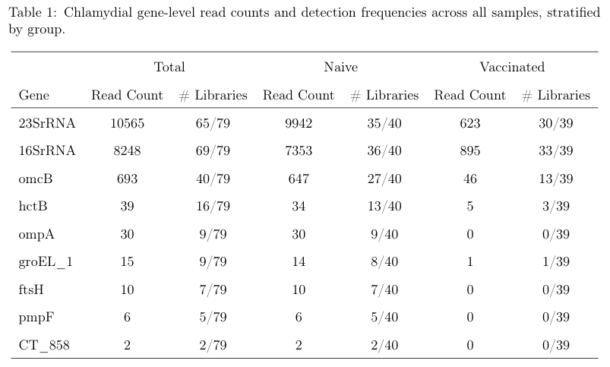
Chlamydia RNA Count
Notes:
Before looking at host gene expression patterns, I summarized the detected Chlamydia RNA counts and detection frequencies across all samples, stratified by group.
Overall, the naive group had substantially higher chlamydial read counts than the vaccinated group across the targeted genes. The strongest signals were from 23S rRNA and 16S rRNA, followed by omcB. In contrast, several genes such as pmpF and CT_858 were rarely detected.
So the main takeaway from this table is that chlamydial transcript detection was much higher in naive mice, which is consistent with reduced bacterial burden in the vaccinated group.

Slide 9
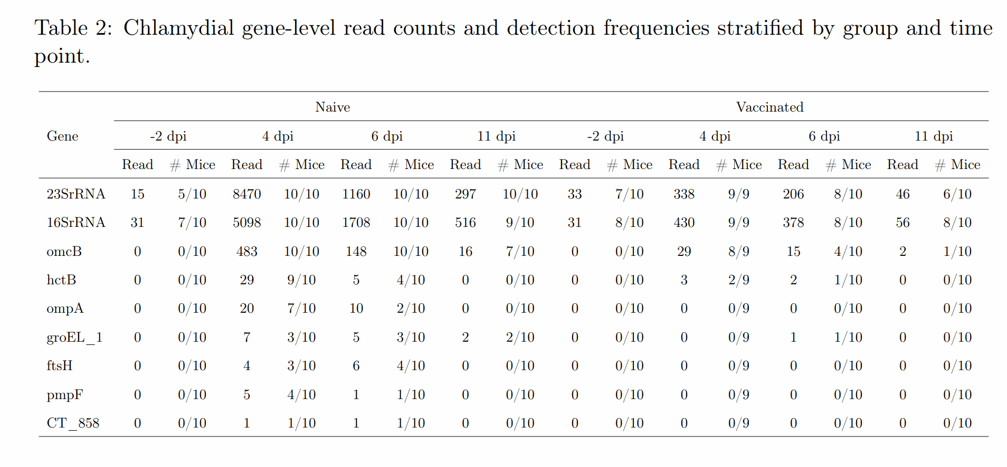

Slide 10
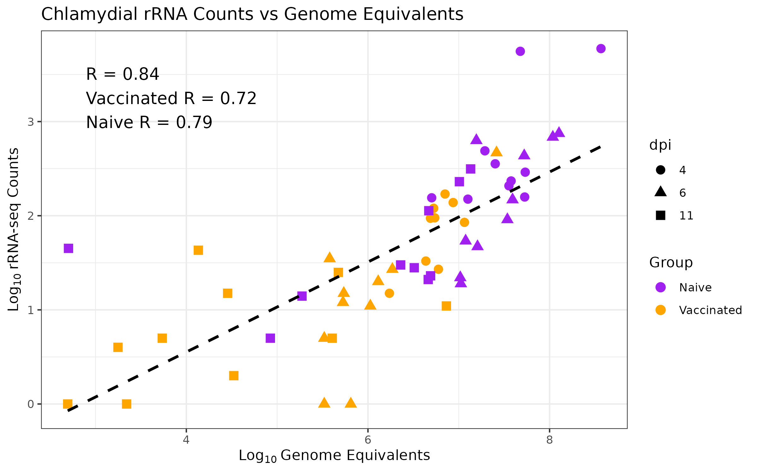
Chlamydial rRNA Counts vs Genome Equivalents
Notes:
Here, I compared chlamydial rRNA counts with genome equivalents. Overall, they were strongly positively correlated, with an overall correlation of 0.84. This suggests that higher chlamydial rRNA counts generally corresponded to higher bacterial burden, supporting the use of these RNA counts as a transcript-level indicator of chlamydial signal.

Slide 11
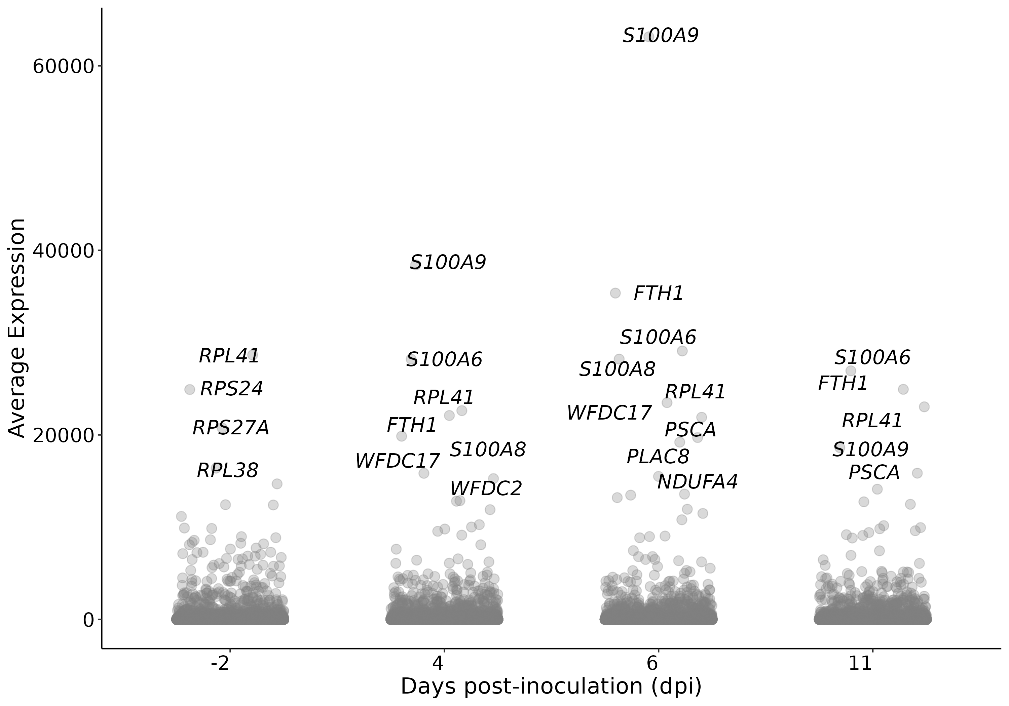
Average Mouse Gene Expression Across Timepoints
Notes:
Here is a summary plot showing the mean raw expression of each mouse gene across samples within each time point. The top 10 most highly expressed genes at each time point are labeled.
This plot is mainly intended as a broad overview of the most abundant host transcripts, rather than a formal differential expression result. Most genes had relatively low average expression, while a smaller number of genes showed much higher expression. Some labeled genes, such as S100A8 and S100A9, may be biologically interesting in the context of infection and inflammation.
Next, I used PCA to examine the overall sample-level expression patterns after QC filtering.

Slide 12
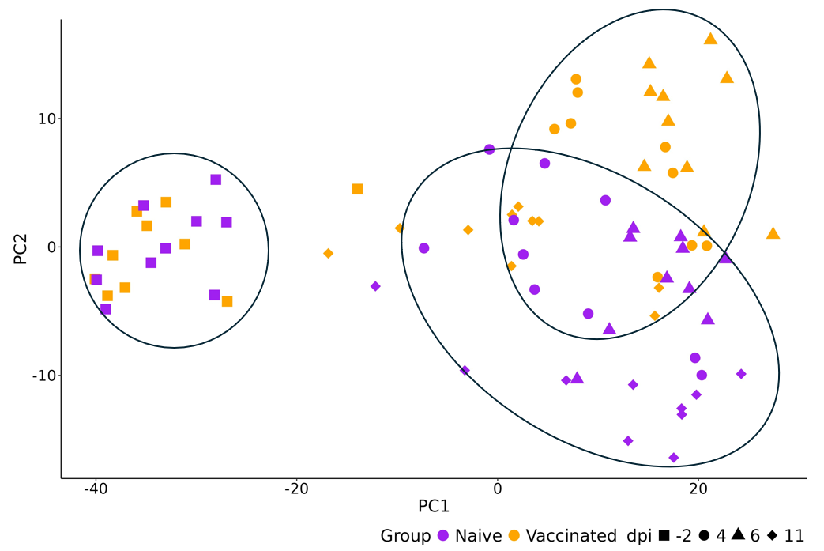
PCA of Host Gene Expression
Notes:
Here is my PCA plot. Color indicates group, with purple for naive and orange for vaccinated, and shape indicates infection time point.
Visually, we can see three broad clusters. The day −2 baseline samples cluster together on the left, separate from the post-infection samples. Among the post-infection samples, the naive and vaccinated samples show some group-related separation, but there is still overlap between the two groups.
So overall, the PCA suggests that infection time is the strongest driver of host gene expression patterns, while vaccination status also appears to contribute to the variation after infection.

Slide 13
Differential Expression at Each Time Point
Notes:
Next, I’ll move into the differential expression analysis at each time point. The question here is: within each day, which host genes differ between vaccinated and naive mice?
I first checked the baseline day −2 comparison. There were no significant differentially expressed genes after multiple-testing correction, with all adjusted p-values greater than 0.05. Because of that, I will not show a volcano plot for day −2, and will instead focus on the post-infection time points.

Slide 14
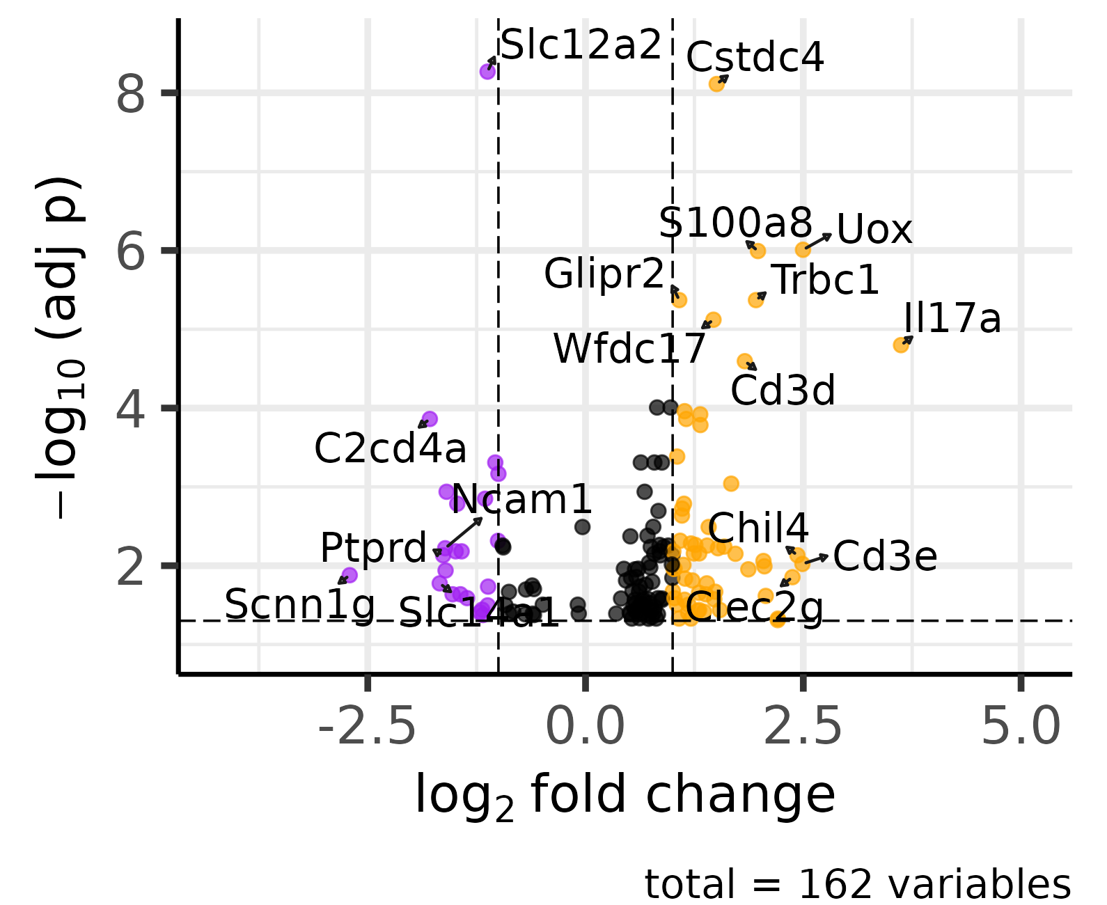
Day 4 Differential Expression: Vaccinated vs Naive Mice
Orange: up-regulated in vaccinated mice;
Purple: up-regulated in naïve mice
Horizontal dashed line: −log10​(0.05)≈1.301;
Vertical dashed lines: log2​FC=−1and log2​FC=1
Notes:
This volcano plot shows the timepoint-specific differential expression results comparing vaccinated versus naive mice.
Each point represents one gene. The x-axis shows the log2 fold change for vaccinated versus naive mice. Genes on the right have higher expression in vaccinated mice, while genes on the left have higher expression in naive mice.
The y-axis shows the negative log10 adjusted p-value, so genes higher on the plot have stronger statistical evidence after multiple-testing correction. Orange and purple points are genes that pass both the adjusted p-value cutoff and the log2 fold-change cutoff. Orange genes are higher in vaccinated mice, and purple genes are higher in naive mice.
For Day 4 specifically, there were 162 genes significant after FDR correction. Among the larger fold-change genes, several were higher in vaccinated mice, including Cstdc4, Uox, Trbc1, and Il17a, while genes such as Slc12a2 and C2cd4a were higher in naive mice.

Slide 15
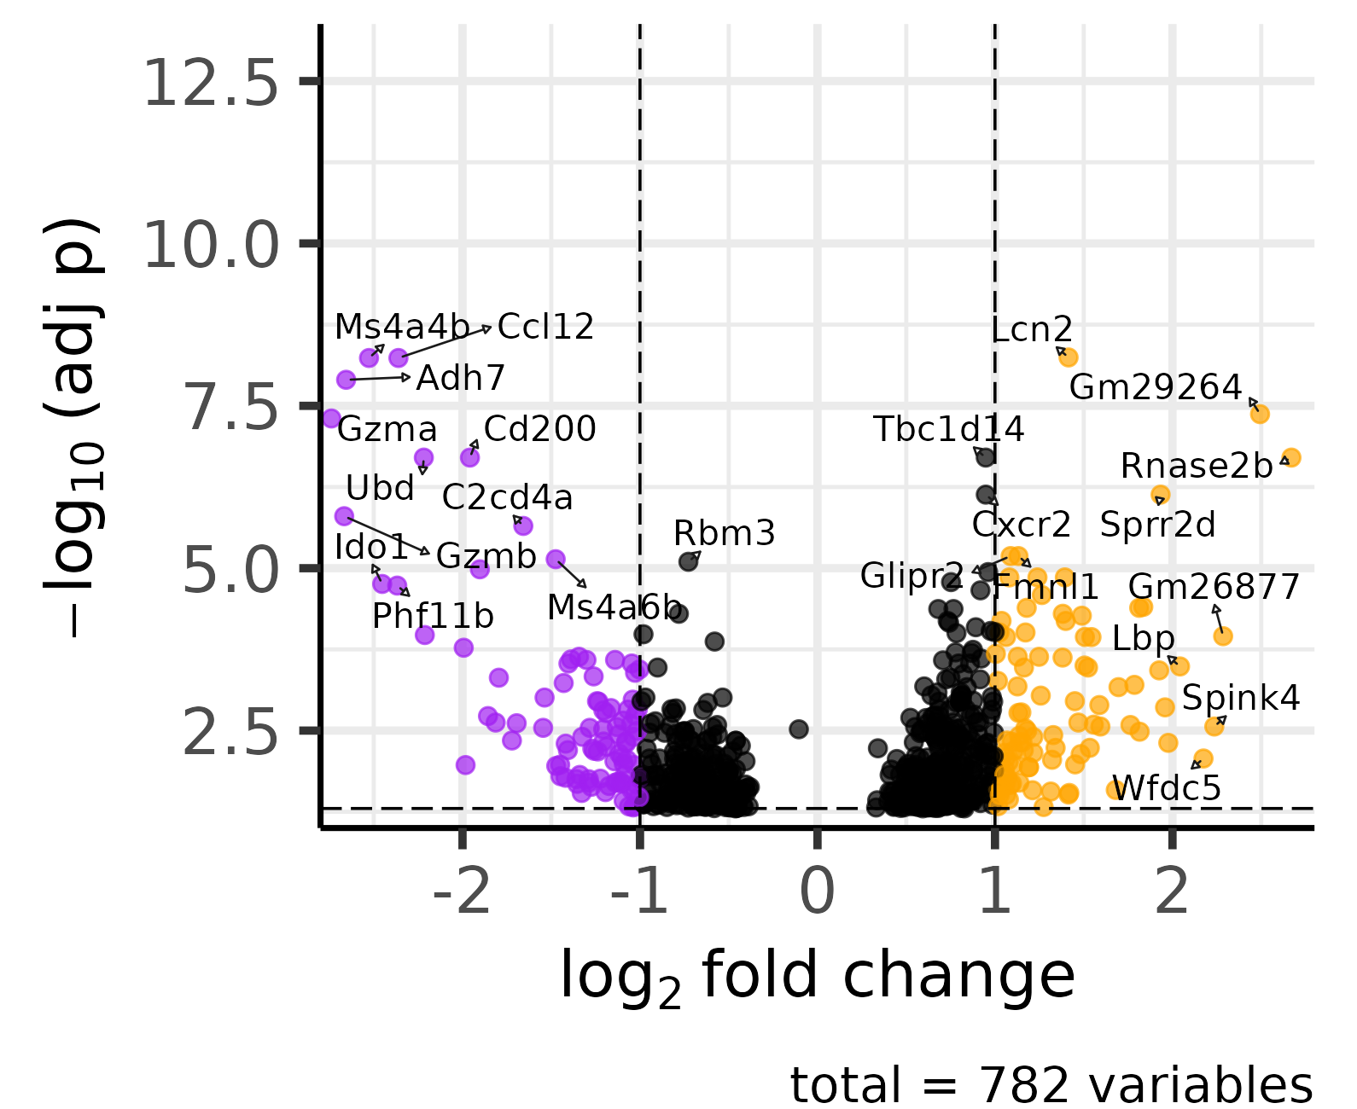
Day 6 Differential Expression: Vaccinated vs Naive Mice
Orange: up-regulated in vaccinated mice;
Purple: up-regulated in naïve mice
Horizontal dashed line: −log10​(0.05)≈1.301;
Vertical dashed lines: log2​FC=−1and log2​FC=1
Notes:
At Day 6, there were 782 significant genes. And there was a larger group of genes upregulated in vaccinated mice, shown in orange.

Slide 16
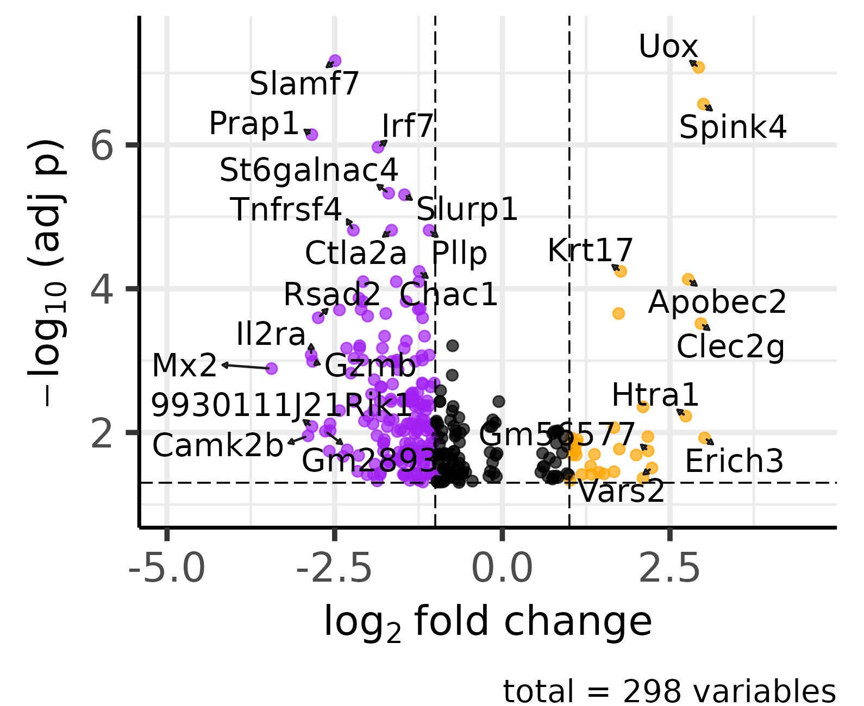
Day 11 Differential Expression: Vaccinated vs Naive Mice
Orange: up-regulated in vaccinated mice;
Purple: up-regulated in naïve mice
Horizontal dashed line: −log10​(0.05)≈1.301;
Vertical dashed lines: log2​FC=−1and log2​FC=1
Notes:
At Day 11, there were 298 genes significant after FDR correction. Compared with Day 6, more genes were upregulated in naive mice.

Slide 17
Time Interaction
Differential Expression
Notes:
So far, the differential expression analysis compared vaccinated and naive mice within each individual time point.
Next, Next, I looked at time interaction differential expression, which tests whether the change from baseline differs between vaccinated and naive mice at each post-infection time point.

Slide 18
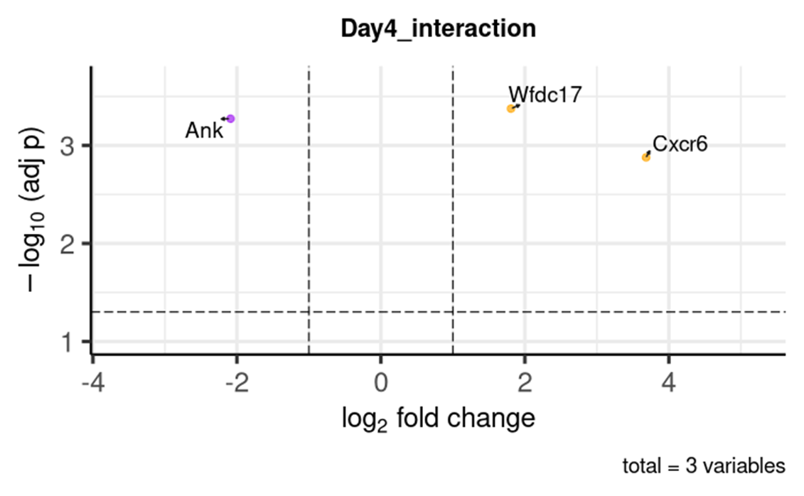
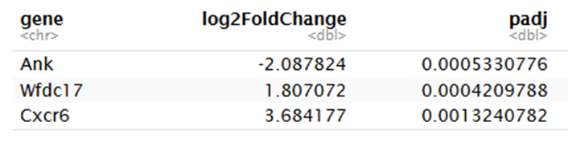
Day 4 Group-by-Time Interaction Volcano Plot
Positive log₂FC indicates a stronger day 4 change in vaccinated mice relative to naive mice.
Negative log₂FC indicates a stronger day 4 change in naive mice relative to vaccinated mice.
Model reference: Naive at −2 dpi.
Notes:
For the time interaction results, the interpretation of log2 fold change is different from the previous volcano plots.
Here, the model reference is naive mice at day −2. On the x-axis, positive values mean the baseline-to-Day 4 change was larger in vaccinated mice. Negative values mean the baseline-to-Day 4 change was larger in naive mice.
At Day 4, only three genes were significant after FDR correction: Ank, Wfdc17, and Cxcr6.
Wfdc17 and Cxcr6 had positive interaction effects, while Ank had a negative interaction effect.

Slide 19
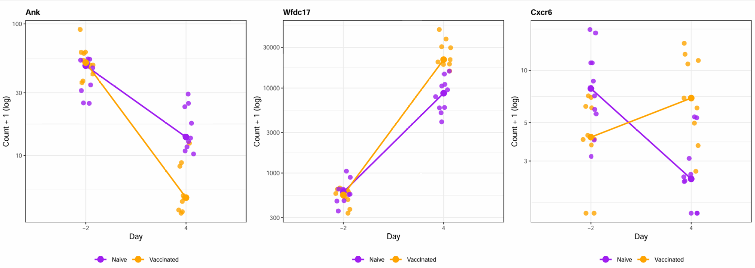
Significant Day 4 Group-by-Time Interactions
*The large dot on the line is the group median at each day.
Notes:
The line plots here show how the significant Day 4 interaction genes behaved in individual samples.
Each small point represents one sample, and the larger points connected by lines show the group median at each day. The y-axis is normalized gene count plus 1 on the log scale.
For Ank, expression decreased from baseline to Day 4 in both groups, but the decrease was stronger in vaccinated mice. For Wfdc17, expression increased from baseline to Day 4 in both groups, with a larger increase in vaccinated mice. For Cxcr6, the two groups showed opposite patterns, with expression decreasing in naive mice but increasing in vaccinated mice.

Slide 20
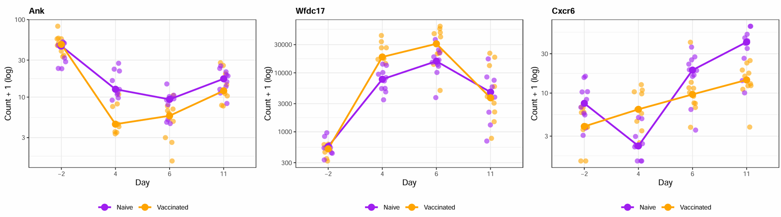
Expression Trajectories of Day 4 Interaction Genes
* Y-axis is shown on a log10 scale; 1 was added to allow zero counts to be plotted.
Notes:
This figure shows the expression trajectories for the three significant genes.
Even though these genes were selected based on the Day 4 interaction test, I’m showing all time points here to help visualize their broader expression trajectories.

Slide 21
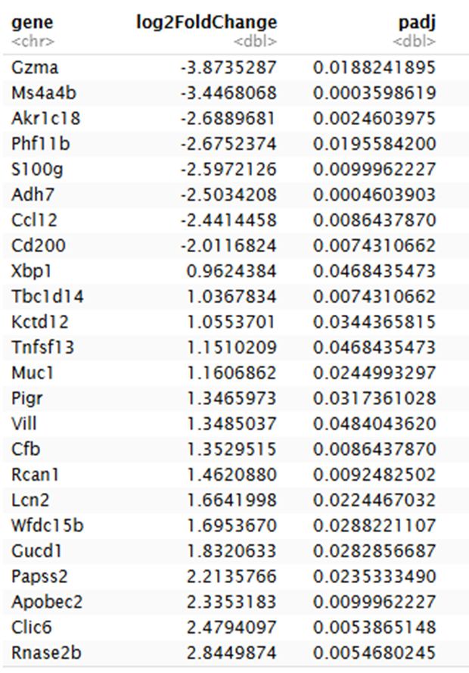
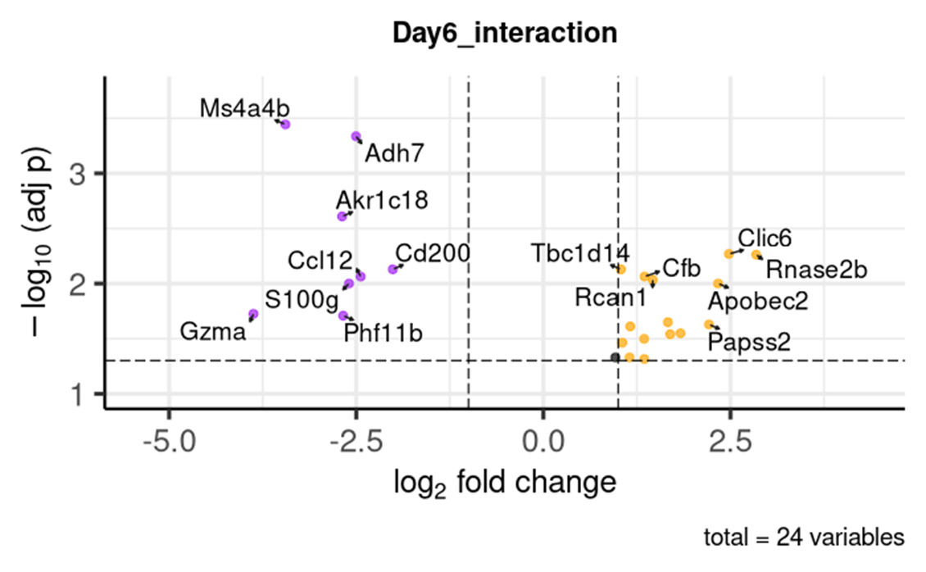
Day 6 Group-by-Time Interaction Volcano Plot
Model reference: Naive at −2 dpi.
Notes:
Here is the time interaction volcano plot for Day 6 compared with baseline. There were 24 significant interaction genes.

Slide 22
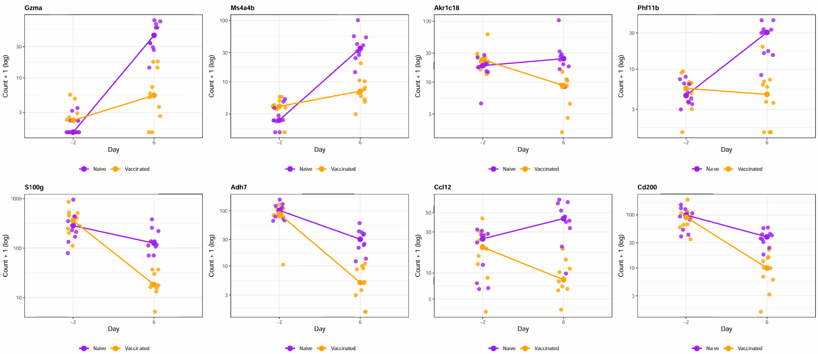
Significant Day 6 Group-by-Time Interactions Examples
Notes:
Here are some example line plots for the Day 6 interaction genes. Since there were 24 significant genes, I only included 8 representative examples on this slide. The full set of plots is saved in our Teams folder.

Slide 23
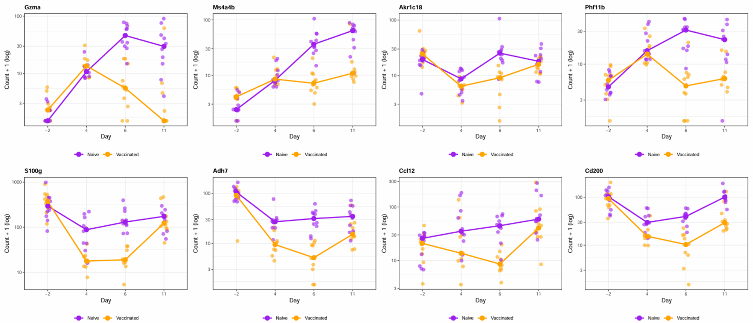
Expression Trajectories of Day 6 Interaction Genes
Notes:
Here are some example trajectory plots for the Day 6 interaction genes. The full set of plots is also saved in our Teams folder.

Slide 24
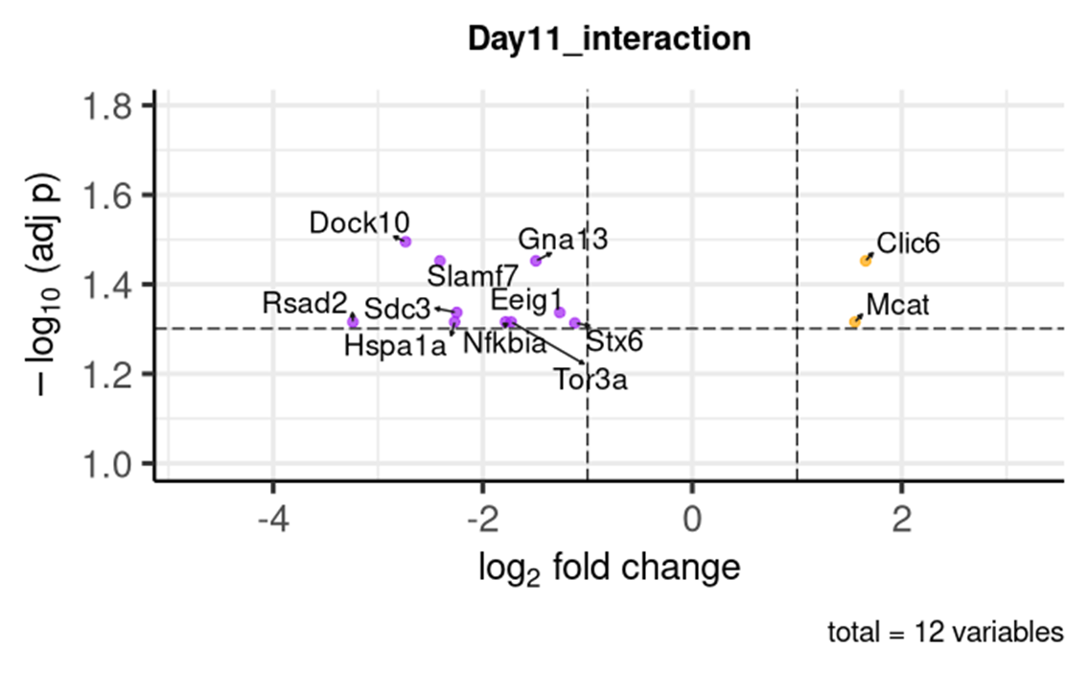
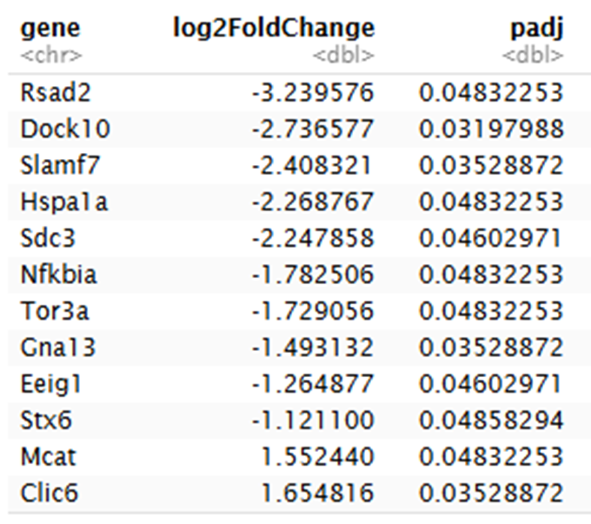
Day 11 Group-by-Time Interaction Volcano Plot
Model reference: Naive at −2 dpi.
Notes:
This volcano plot shows the Day 11 time interaction results relative to baseline. There were 12 significant interaction genes.

Slide 25
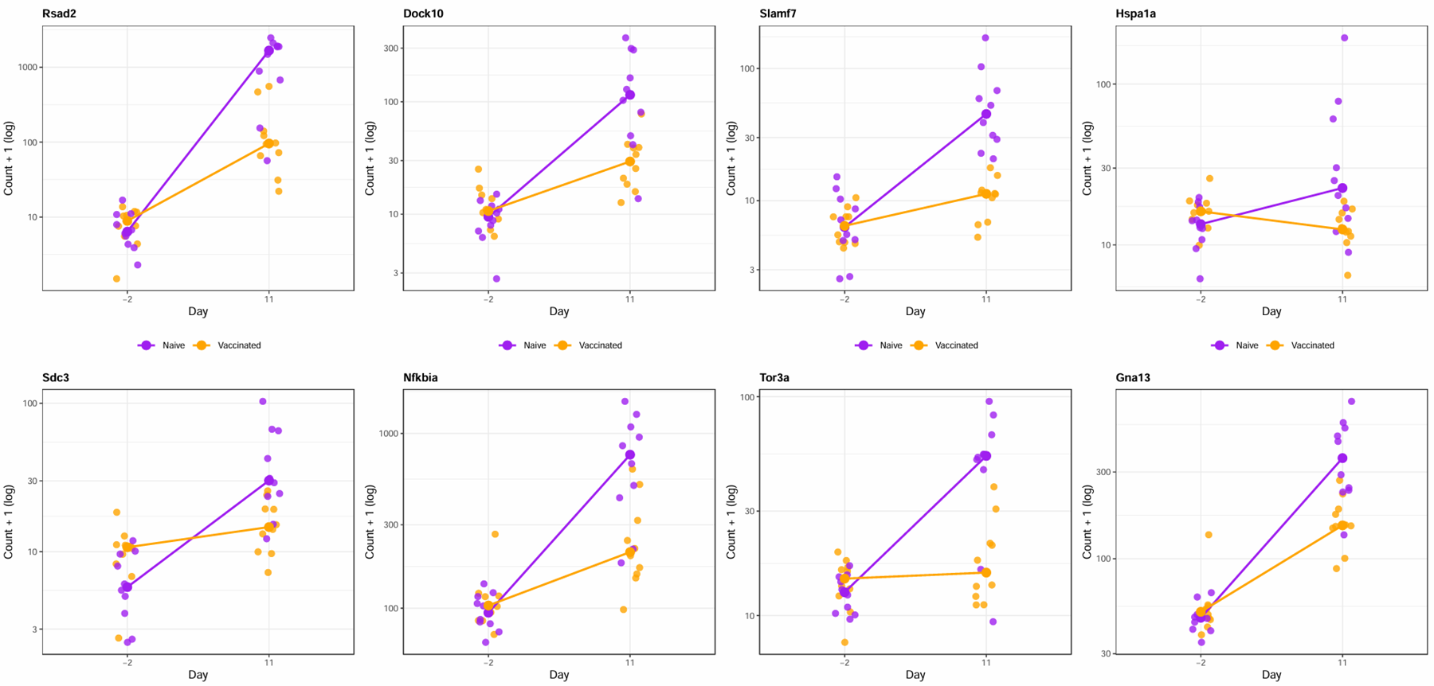
Significant Day 11 Group-by-Time Interactions
Notes:
Here are the line plots for the significant genes at Day11.

Slide 26
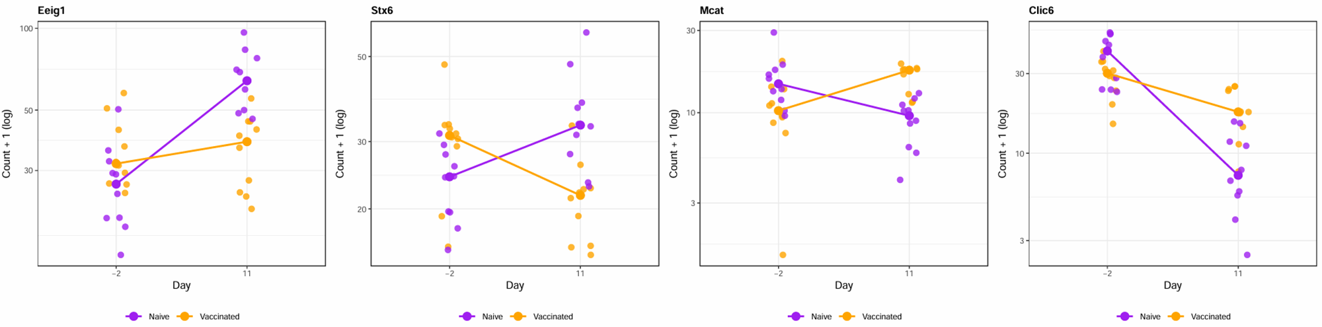
Significant Day 11 Group-by-Time Interactions

Slide 27
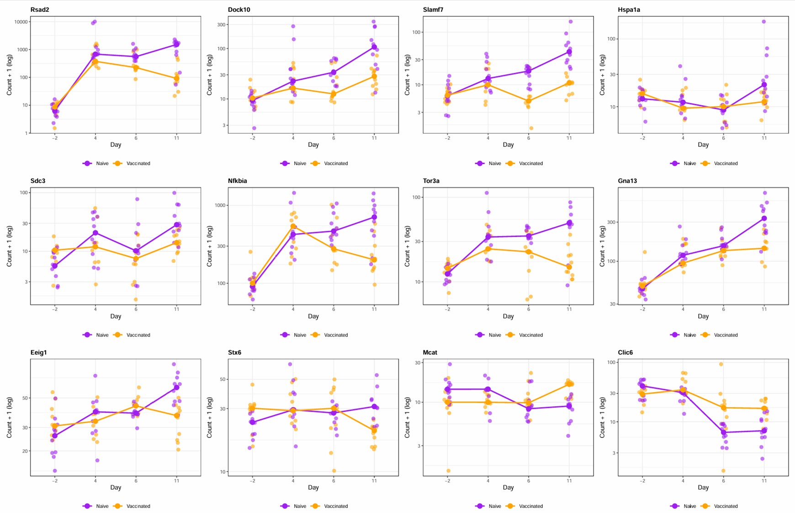
Notes:
Here are the trajectory plots for the significant genes at Day 11

Slide 28
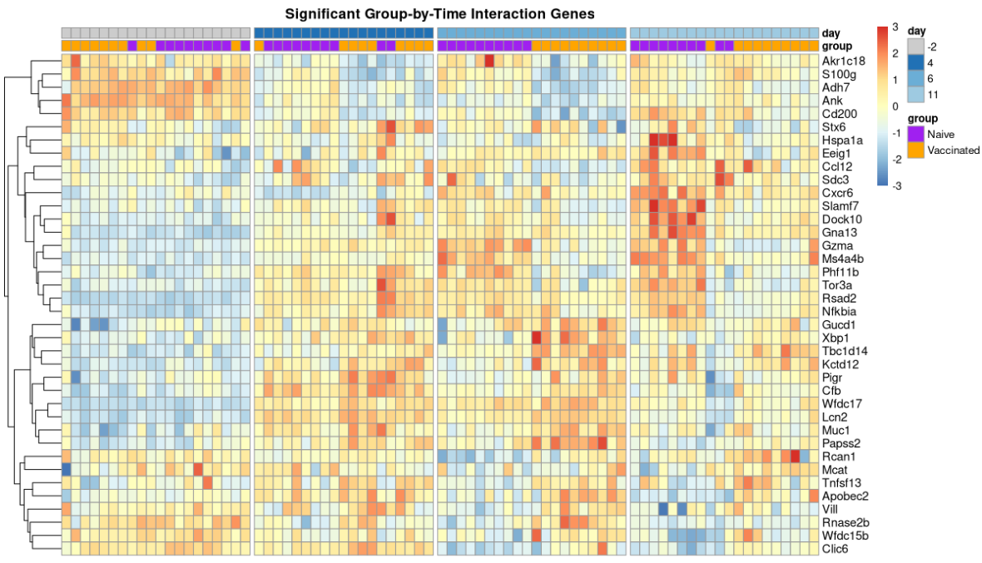
Expression Patterns of Significant Time Interaction Genes
Notes:
This heatmap summarizes the expression patterns of all significant time interaction genes across the full time course.
Each row represents one significant interaction gene, and each column represents one sample. The samples are grouped by time point, with the annotations at the top showing day and vaccination group. The color scale shows row-scaled expression, so red indicates relatively higher expression for that gene and blue indicates relatively lower expression.

Slide 29
Shared Time Effect Analysis
Notes:
Next, I looked at the shared time effect. In this analysis, I first excluded genes that had significant group-by-time interaction effects. Then, among the remaining genes, I tested which genes changed from baseline to each post-infection time point in a similar way across vaccinated and naive mice.

Slide 30
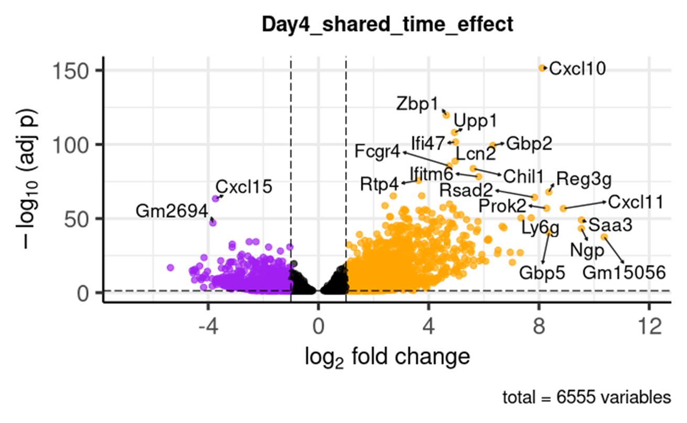
Day 4 Shared Time Effect Volcano Plot
Orange: upregulated at Day 4 vs baseline
Purple: downregulated at Day 4 vs baseline
Interaction-significant genes excluded
Notes:
This volcano plot shows the shared Day 4 time effect after excluding genes with significant group-by-time interaction effects.
Here, 6,555 genes showed significant baseline-to-Day 4 changes across both groups. Most of the large fold-change genes were upregulated from baseline to Day 4, shown in orange.
Orange genes are higher at Day 4 than at baseline, and purple genes are lower at Day 4 than at baseline.

Slide 31
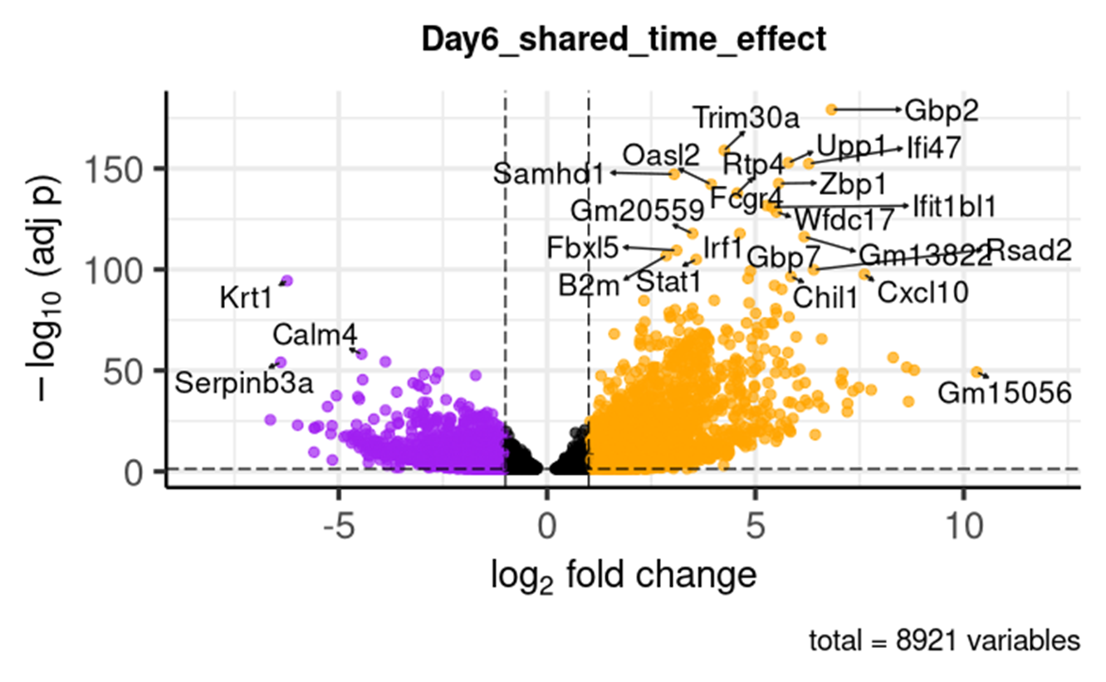
Day 6 Shared Time Effect Volcano Plot
Orange: upregulated at Day 6 vs baseline
Purple: downregulated at Day 6 vs baseline
Notes:
In this volcano plot, 8,921 genes showed significant shared changes from baseline to Day 6. Most of the significant genes were upregulated at Day 6 compared with baseline.

Slide 32
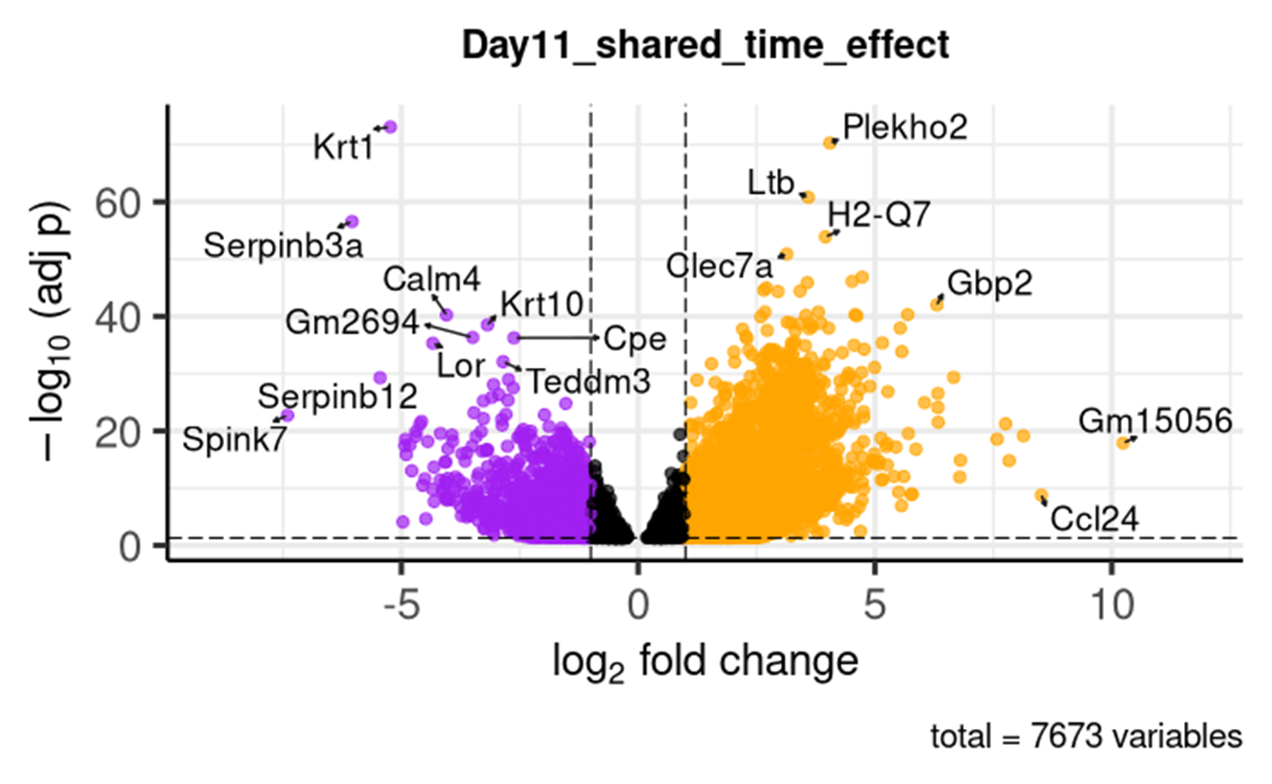
Day 11 Shared Time Effect Volcano Plot
Orange: upregulated at Day 6 vs baseline
Purple: downregulated at Day 6 vs baseline
Notes:
At Day 11, 7673 genes changed significantly from baseline.

Slide 33
Gene Set Enrichment Analysis
M7 (immunologic gene sets)
M8 (cell type signature gene sets)
KEGG
M2 -> CP:REACTOME (curated gene sets)
Notes:
Finally, I performed gene set enrichment analysis using the timepoint-specific differential expression results. The goal was to identify which biological pathways were associated with the differences between vaccinated and naive mice at each post-infection time point.
I used four gene set collections: M7 immunologic gene sets, M8 cell-type gene sets, KEGG pathways, and Reactome curated pathways.

Slide 34
Day 4

Slide 35
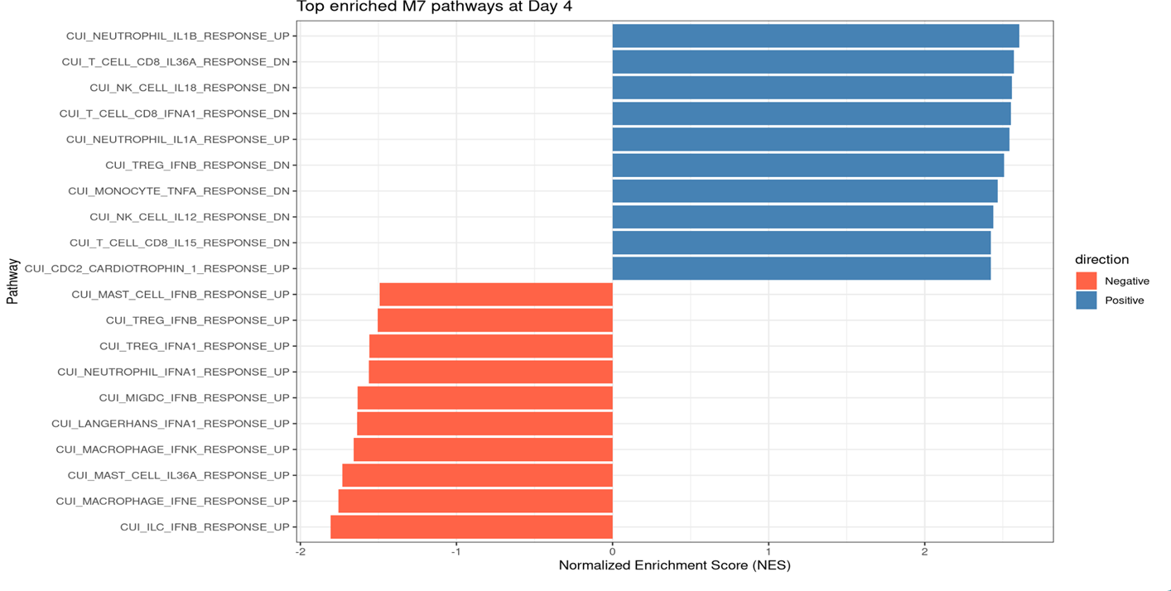
Top Enriched M7 pathways at Day 4
Notes:
In this GSEA bar plot, each bar represents an enriched immunologic gene set. The x-axis is the normalized enrichment score. Positive scores, shown in blue, indicate gene sets enriched among genes higher in vaccinated mice at Day 4. Negative scores, shown in red, indicate gene sets enriched among genes higher in naive mice at Day 4.

Slide 36
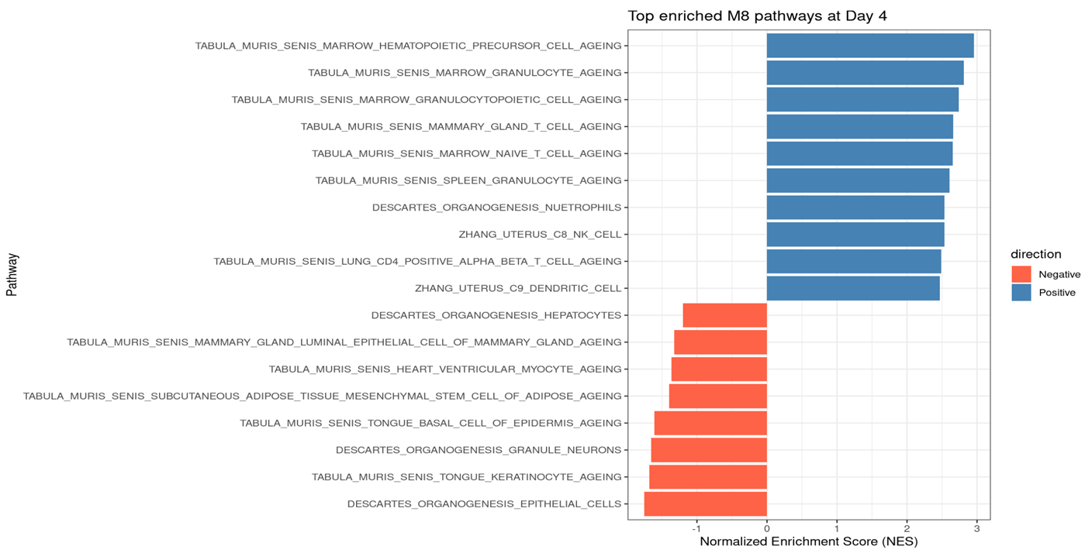
Top Enriched M8 Pathways at Day 4

Slide 37
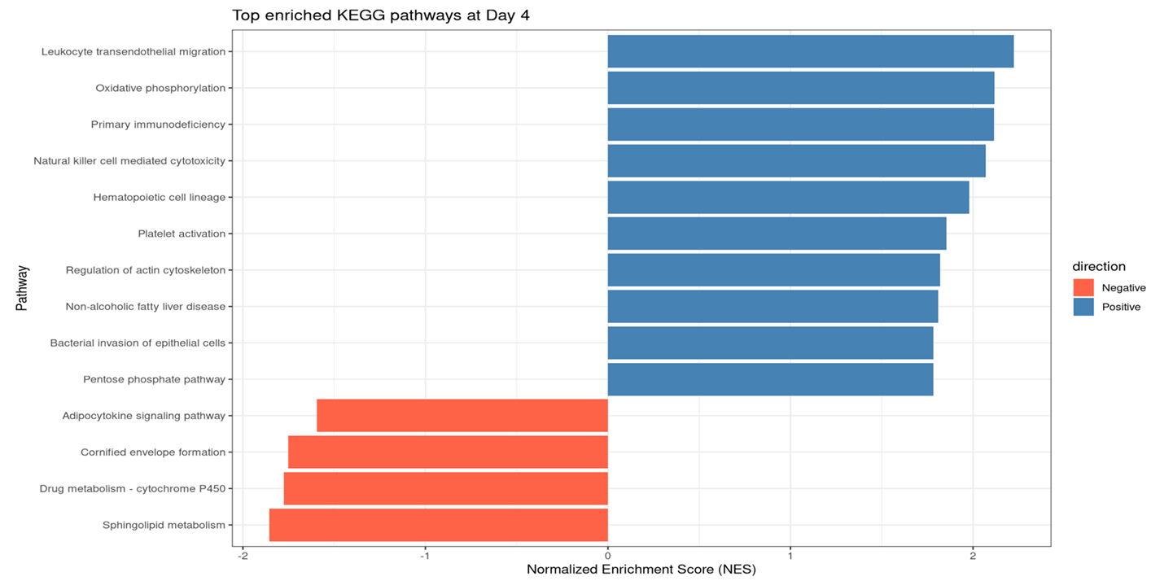
Top Enriched KEGG Pathways at Day 4

Slide 38
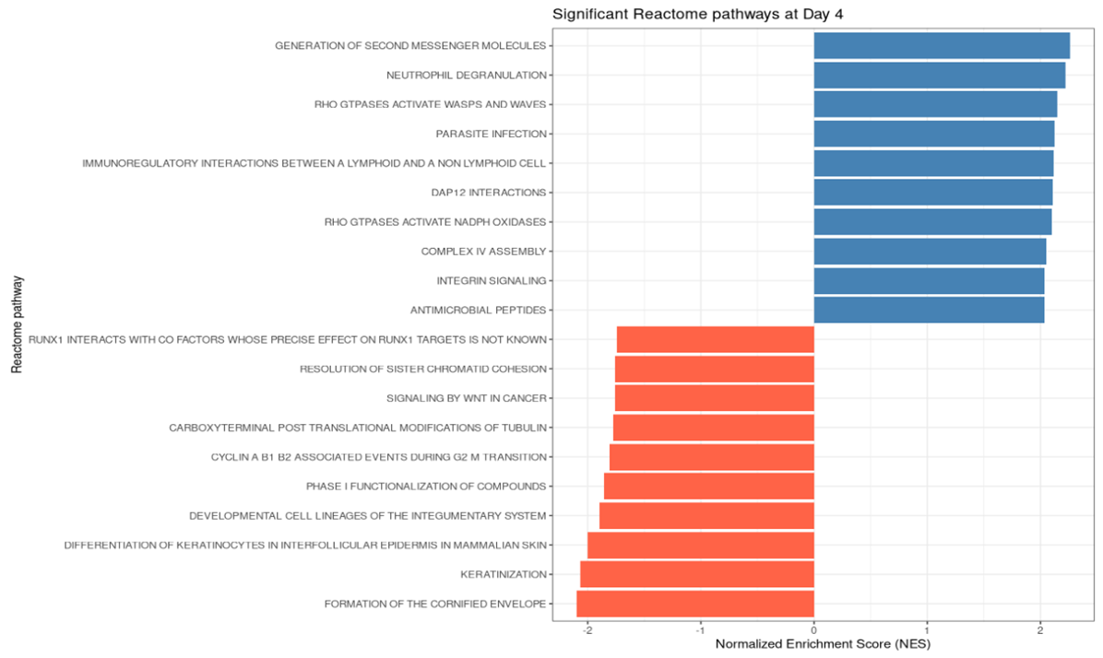
Top Enriched Reactome Pathways at Day 4

Slide 39
Day 6

Slide 40
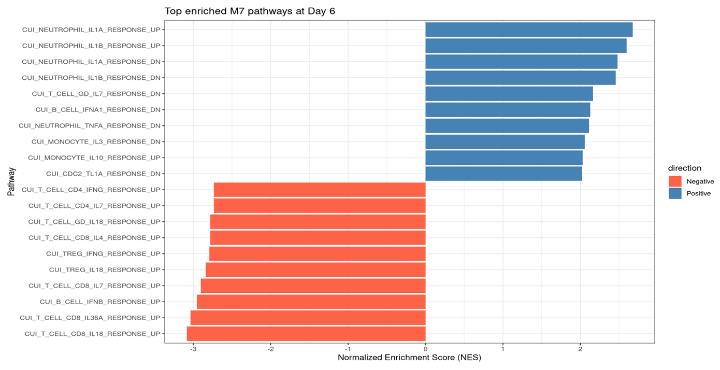
Top Enriched M7 Pathways at Day 6

Slide 41
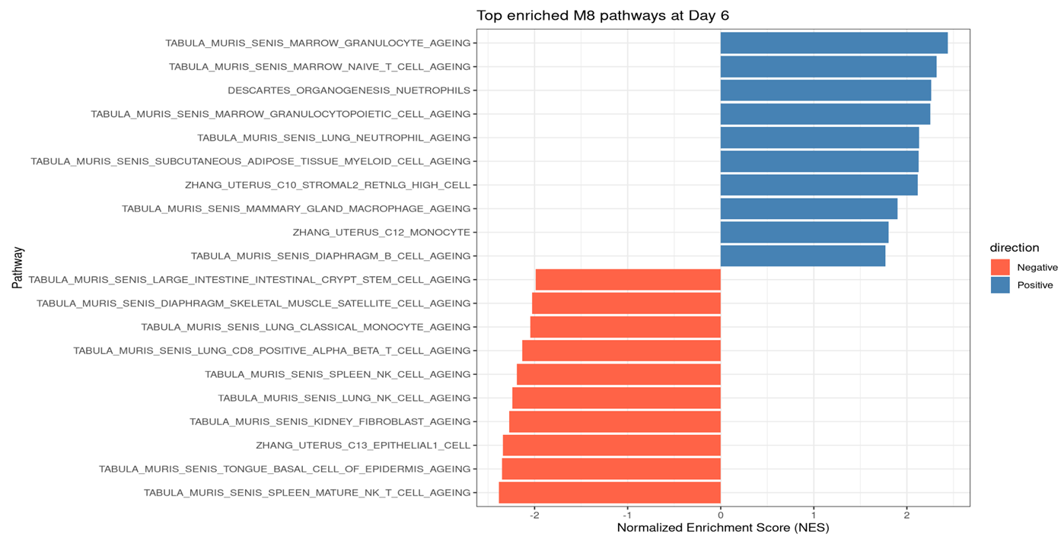
Top Enriched M8 Pathways at Day 6

Slide 42
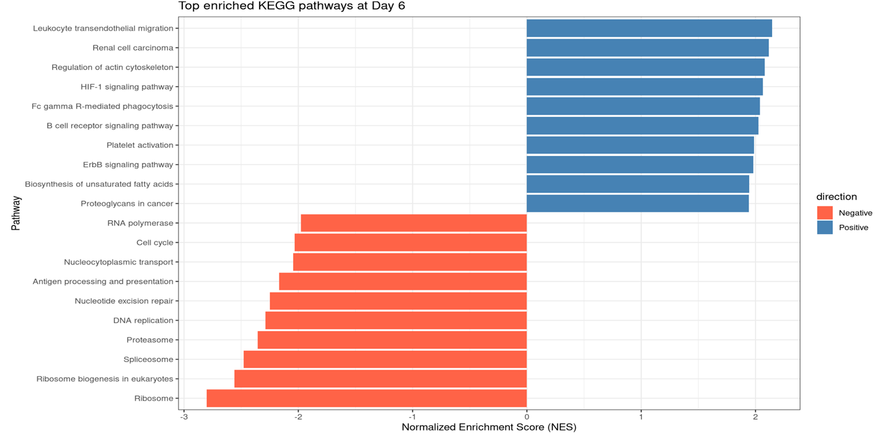
Top Enriched KEGG Pathways at Day 6

Slide 43
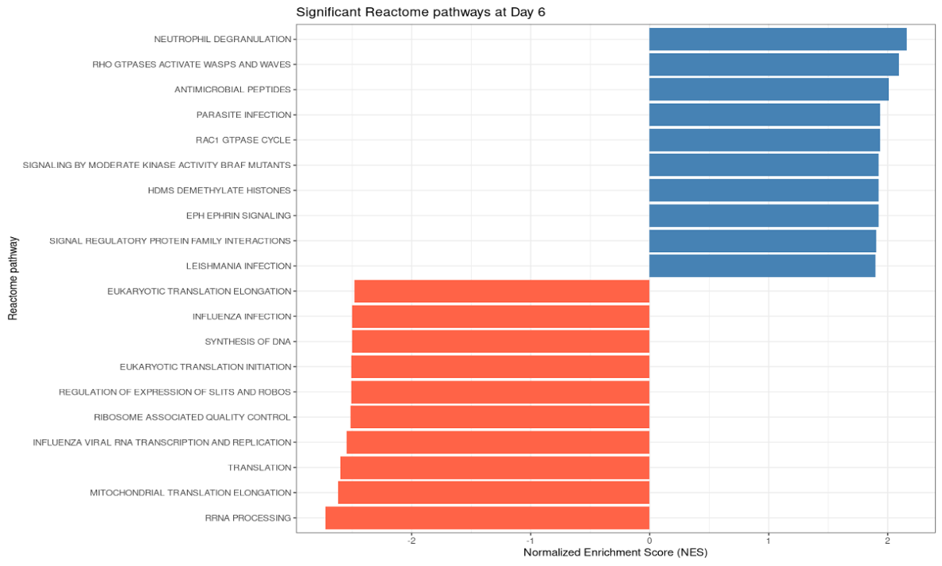
Top Enriched Reactome Pathways at Day 6

Slide 44
Day 11

Slide 45
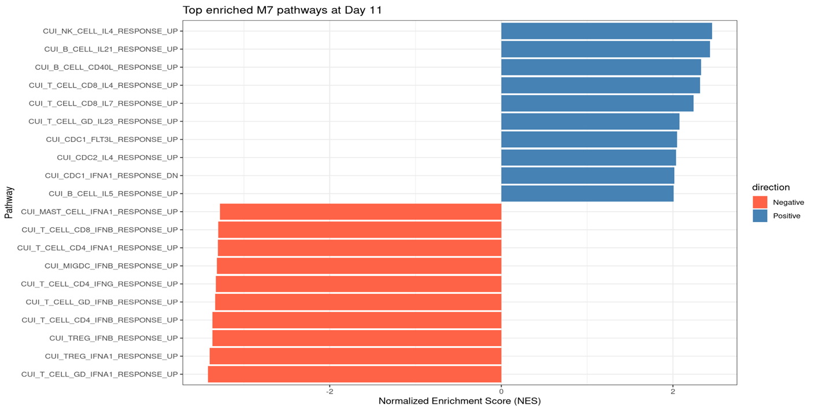
Top Enriched M7 Pathways at Day11

Slide 46
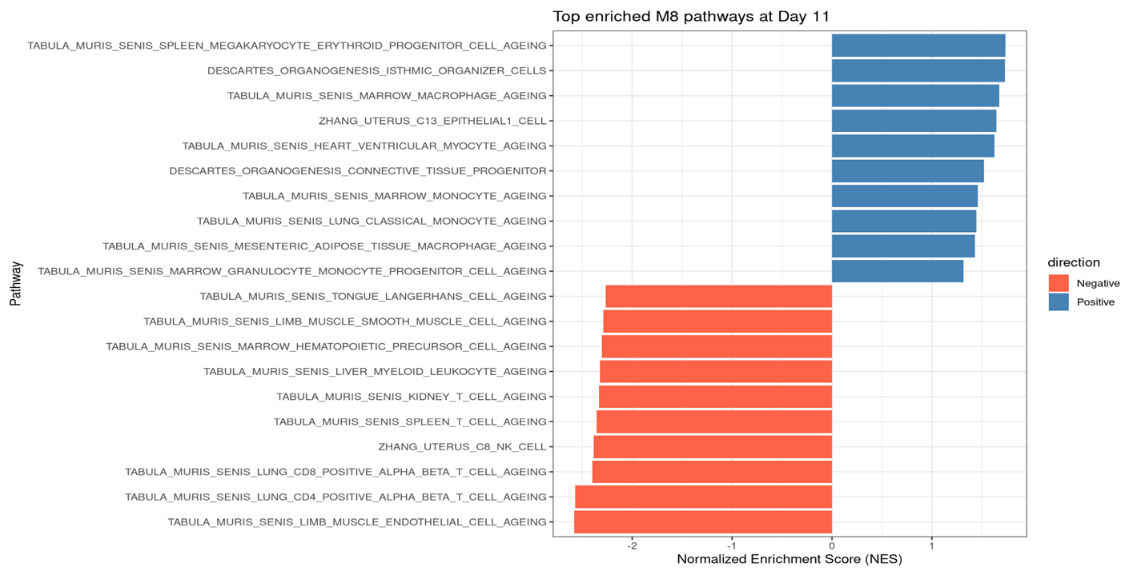
Top Enriched M8 Pathways at Day11

Slide 47
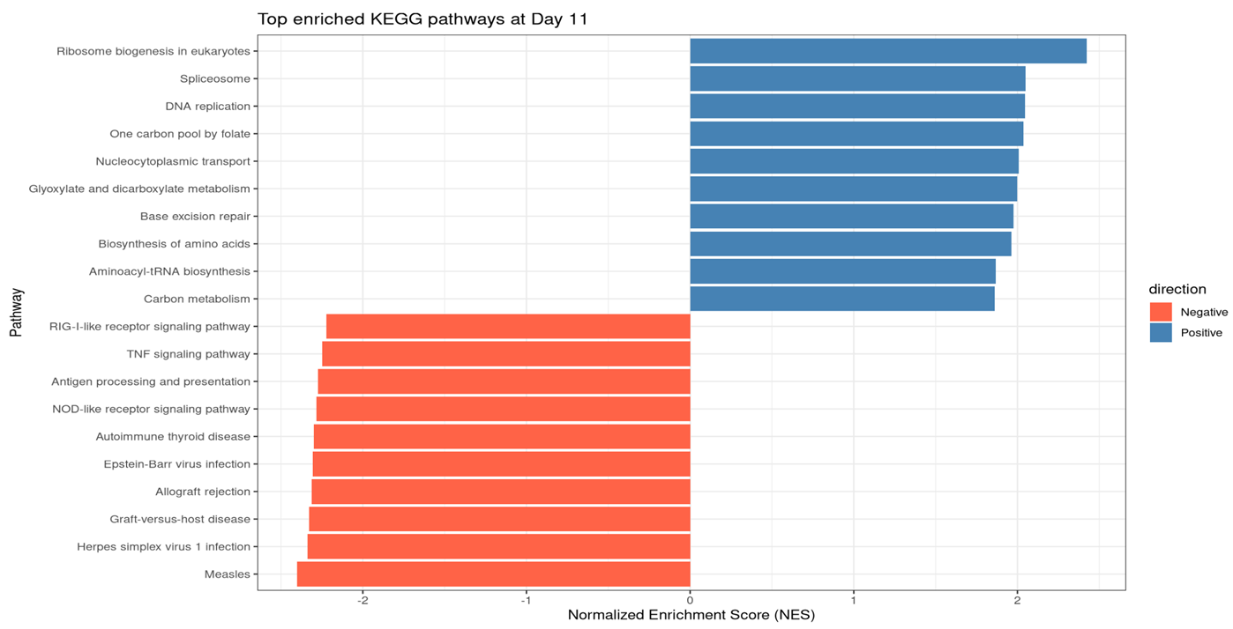
Top Enriched KEGG Pathways at Day 11

Slide 48
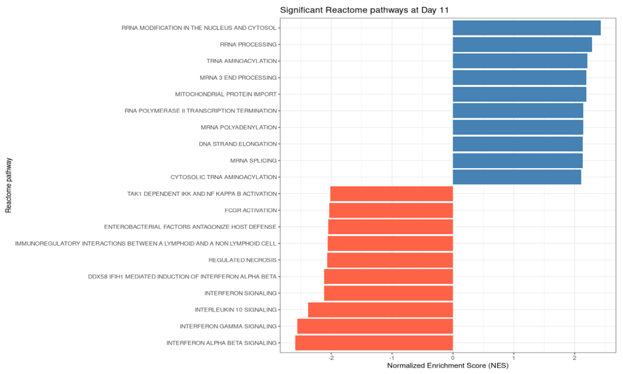
Top Enriched Reactome Pathways at Day 11

Slide 49
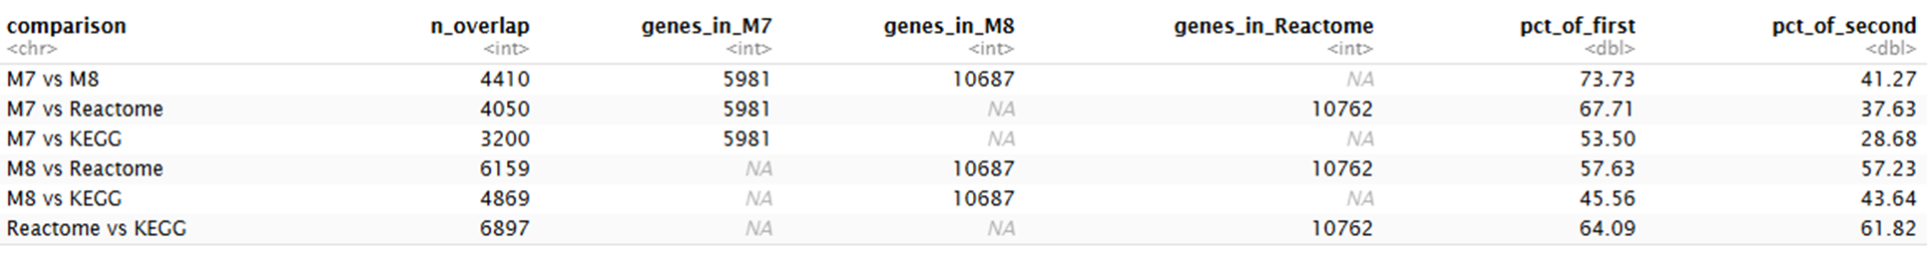
Overlapping genes
Notes:
Here, I checked the overlap between the gene set collections used for GSEA. There is substantial overlap among M7, M8, KEGG, and Reactome, especially between Reactome and KEGG.

Slide 50
Questions?

Slide 52
Supplement

Slide 53
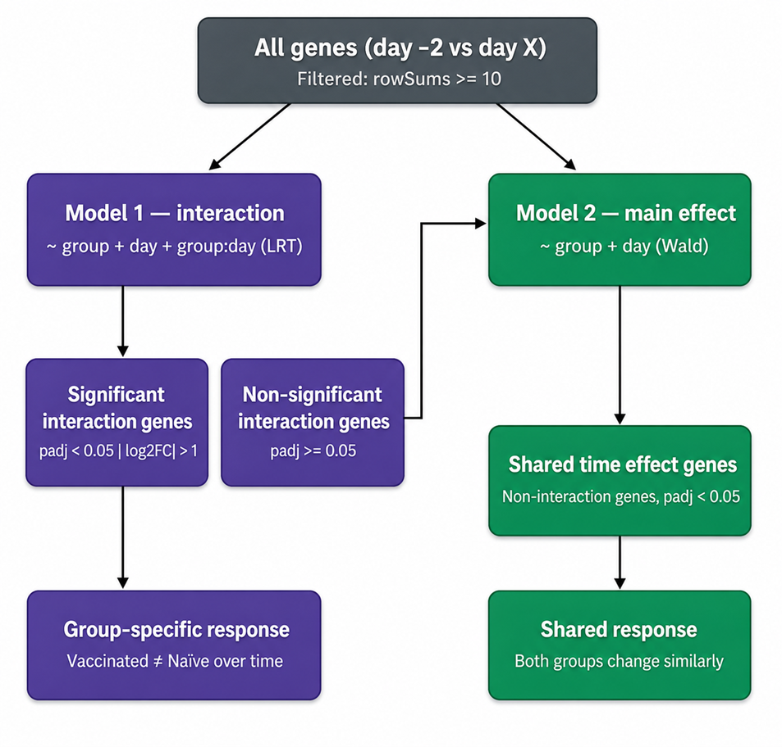
Two-Model Strategy for Time-Course DE Analysis

Slide 54
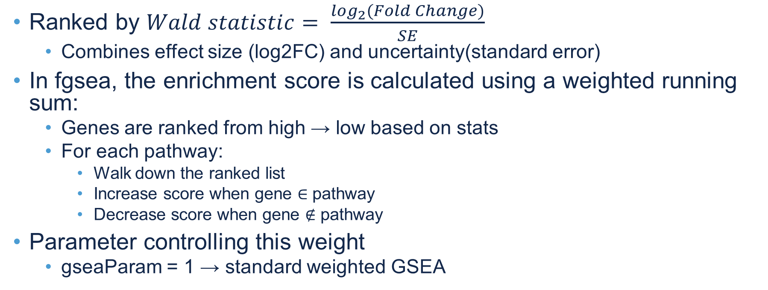
Previous Questions
Ranked by $Wald statistic= \frac{\log_{2}(Fold Change)}{SE}$
  Combines effect size (log2FC) and uncertainty(standard error)
In fgsea, the enrichment score is calculated using a weighted running sum:
  Genes are ranked from high → low based on stats
  For each pathway:
    Walk down the ranked list
    Increase score when gene ∈ pathway
    Decrease score when gene ∉ pathway
Parameter controlling this weight
  gseaParam = 1 → standard weighted GSEA
Notes:
Genes were ranked using the Wald statistic from DESeq2, defined as the log2 fold change divided by its standard error. This ranking metric incorporates both the magnitude of expression change and its associated variability, allowing more reliable prioritization of consistently differentially expressed genes in gene set enrichment analysis.

Slide 55
